Slide 1
Many minds. Clearer thinking.
Give every perspective a seat.
Small Council

Slide 2
Start with the question
Name the decision you want to make.
Bring the context that matters.
Invite different AI perspectives.
Notes:
This is a Small Council design specimen. The question, advisors, and outcomes in the example are fictional. AI perspectives require human review.

Slide 3
Compare before deciding

Slide 4
Different views reveal different questions
Strategist
Define the intended outcome.
Keep the constraints visible.
Critic
Examine the assumptions.
Ask what could change the plan.
Notes:
These are illustrative AI advisor roles, not fixed system personas. Their expertise labels do not establish that their claims are correct.

Slide 5
Choose how to work together
Mode | Purpose
Open | Invite particular advisors
Brainstorming | Explore possibilities
Consensus | Work toward agreement
Notes:
Agreement is not proof of factual correctness. A generated summary must not be mistaken for explicit participant agreement.

Slide 6
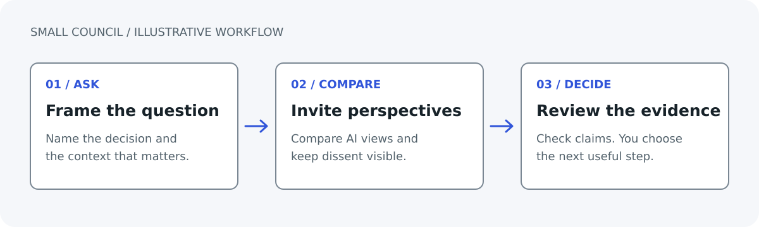
Keep the person in control
An illustrative question-to-decision workflow.
Notes:
This describes a review pattern rather than an automated sequence guaranteed by the application. The user examines the evidence and chooses the next step.

Slide 7
Preserve useful disagreement
Make unresolved concerns visible.
Separate facts from assumptions.
Review the recommendation yourself.

Slide 8
Keep context reviewable
Organize related conversations in spaces.
Review the memories you keep.
Correct context when circumstances change.
Notes:
Do not promise perfect recall or treat inferred notes as confirmed facts. Use the actual memory controls available in the app.

Slide 9
Decide what to learn next
For this fictional workshop question, ask prospective participants about their needs before choosing the pilot format.
Notes:
This is an example next step, not an approved action or a real customer result.

